Slide 1
Access Chapter 1
Creating and Using a Database

Slide 2
Objectives
Describe databases and database management systems
Design a database to satisfy a collection of requirements
Start Access
Describe the features of the Access window
Create a database

Slide 3
Objectives
Create a table and add records
Close a table
Close a database and quit Access
Open a database

Slide 4
Objectives
Print the contents of a table
Create and print custom reports
Create and use a split form
Use the Access Help system

Slide 5
Plan Ahead
Identify the tables
Determine the primary keys
Determine the additional fields
Determine relationships among the tables
Determine data types for the fields
Identify and remove any unwanted redundancy
Determine a location for your database

Slide 6
Starting Access
Click the Start button on the Windows taskbar to display the Start menu
Point to All Programs on the Start menu to display the All Programs submenu
Point to Microsoft Office on the All Programs submenu to display the Microsoft Office submenu
Click Microsoft Office Access 2007 to start Access and display the Getting Started with Microsoft Office Access screen
If the Access window is not maximized, click the Maximize button next to the Close button on its title bar to maximize the window

Slide 7
Starting Access

Slide 8
Creating a Database
With a USB flash drive connected to one of the computer’s USB ports, click Blank Database to create a new blank database
Repeatedly press the DELETE key to delete the default name of Database1
Type JSP Recruiters in the File Name text box to replace the default file name of Database1 (your screen may show Database1.accdb). Do not press the ENTER key after typing the file name
Click the ‘Browse for a location to put your database’ button to display the File New Database dialog box
Click the Save in box arrow to display a list of available drives and folders

Slide 9
Creating a Database
Click UDISK 2.0 (E:) in the Save in list to select the USB flash drive, Drive E in this case, as the new save location
Click the OK button to select the USB flash drive as the location for the database and to return to the Getting Started with Microsoft Office Access screen
Click the Create button to create the database on the USB flash drive with the file name, JSP Recruiters
If a Field List appears, click its Close button to remove the Field List from the screen

Slide 10
Creating a Database

Slide 11
Defining the Fields in a Table
Right-click Add New Field to display a shortcut menu
Click Rename Column on the shortcut menu to display an insertion point
Type Client Number to assign a name to the new field
Press the DOWN ARROW key to complete the addition of the field
Right-click Add New Field to display a shortcut menu, click Rename Column on the shortcut menu to display an insertion point, type Client Name to assign a name to the new field, and then press the DOWN ARROW key to complete the addition of the field

Slide 12
Defining the Fields in a Table
Using the same technique add the fields in the Client table up through and including the Amount Paid field
Click the Data Type box arrow to display the Data Type box menu
Click Currency to select Currency as the data type for the Amount Paid
Click the right scroll arrow to shift the fields to the left and display the Add New Field column
Make the remaining entries from the Client table structure shown in the figure on the following slide to complete the structure. Be sure to select Currency as the data type for the Current Due field

Slide 13
Defining the Fields in a Table

Slide 14
Saving a Table
Click the Save button on the Quick Access Toolbar to save the structure of the table
Type Client to change the name to be assigned to the table
Click the OK button to save the structure with the name, Client

Slide 15
Saving a Table

Slide 16
Changing the Primary Key
Click the Design View button on the status bar to move to Design view
Confirm that your data types match those shown in figure 1-35 on page AC 28. Make any necessary corrections to the data types
Click the row selector for the ID field to select the field
Press the DELETE key to delete the field

Slide 17
Changing the Primary Key
Click the Yes button to complete the deletion of the field
With the Client Number field selected, click the Primary Key button to designate the Client Number field as the primary key
Click the Save button to save the changes
Close the Client table by clicking the Close ‘Client’ button

Slide 18
Changing the Primary Key

Slide 19
Adding Records to a Table
Right-click the Client table in the Navigation pane to display the shortcut menu
Click Open on the shortcut menu to open the Client table in Datasheet view
Click the Shutter Bar Open/Close Button to hide the Navigation pane
Click in the Client Number field and type AC34 to enter the first client number. Be sure you type the letters in uppercase so they are entered in the database correctly

Slide 20
Adding Records to a Table
Press the TAB key to complete the entry for the Client Number field
Enter the client name, street, city, state, and postal code by typing the following entries, pressing the TAB key after each one: Alys Clinic as the client name, 134 Central as the street, Berridge as the city, CO as the state, and 80330 as the postal code
Type 0 to enter the amount paid
Press the TAB key to complete the entry for the Amount Paid field

Slide 21
Adding Records to a Table
Type 17500 to enter the current due amount and then press the TAB key to move to the next field
Type 21 as the Recruiter number to complete data entry for the record
Press the TAB key to complete the entry of the first record
Use the techniques shown previously to enter the data for the second record in the Client table

Slide 22
Adding Records to a Table

Slide 23
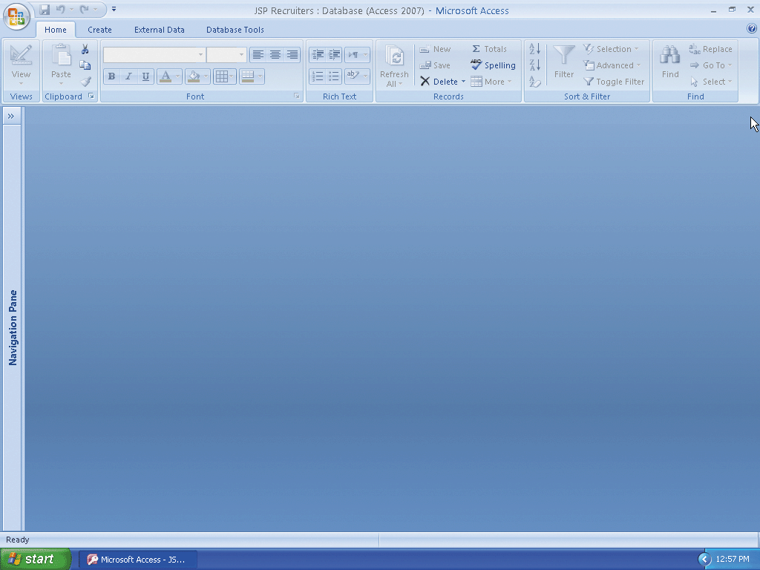
Closing a Table
Click the Close ‘Client’ button, shown in Figure 1–46 on page AC 33, to close the table

Slide 24
Quitting Access
Click the Close button on the right side of the Access title bar, shown in Figure 1–47 on page AC 35 to quit Access

Slide 25
Starting Access
Click the Start button on the Windows taskbar to display the Start menu
Point to All Programs on the Start menu to display the All Programs submenu and then point to Microsoft Office on the All Programs submenu to display the Microsoft Office submenu
Click Microsoft Office Access 2007 on the Microsoft Office submenu to start Access and display the Getting Started with Microsoft Office Access window
If the Access window is not maximized, click the Maximize button on its title bar to maximize the window

Slide 26
Starting Access

Slide 27
Opening a Database from Access
With your USB flash drive connected to one of the computer’s USB ports, click the More button to display the Open dialog box
If necessary, click the Look in box arrow and then click UDISK 2.0 (E:) to select the USB flash drive, Drive E in this case, in the Look in list as the new open location
Click JSP Recruiters to select the file name
Click the Open button to open the database

Slide 28
Opening a Database from Access
If a Security Warning appears, as shown in Figure 1–50 on page AC 38, click the Options button to display the Microsoft Office Security Options dialog box
Click the ‘Enable this content’ option button
Click the OK button to enable the content

Slide 29
Opening a Database from Access

Slide 30
Adding Additional Records to a Table
If the Navigation pane is hidden, click the Shutter Bar Open/Close Button, shown in Figure 1–51, to show the Navigation pane
Right-click the Client table in the Navigation pane to display a shortcut menu
Click Open on the shortcut menu to open the Client table in Datasheet view
Hide the Navigation pane by clicking the Shutter Bar Open/Close button

Slide 31
Adding Additional Records to a Table
Click the New (blank) record button to move to a position to enter a new record
Add the records shown in Figure 1–52, using the same techniques you used to add the first two records
Click the Close ‘Client’ button to close the table

Slide 32
Adding Additional Records to a Table

Slide 33
Previewing and Printing the Contents of a Table
If the Navigation pane is hidden, show the Navigation pane by clicking the Shutter Bar Open/Close Button
Be sure the Client table is selected
Click the Office Button to display the Office Button menu
Point to the Print command arrow to display the Print submenu
Click Print Preview on the Print submenu to display a preview of the report

Slide 34
Previewing and Printing the Contents of a Table
Click the mouse pointer in the position shown in Figure 1–60 on page AC 42 to magnify the upper-right section of the report
Click the Landscape button to change to landscape orientation
Click the Print button on the Print Preview tab to print the report
When the printer stops, retrieve the hard copy of the Client table
Click the Close ‘Client’ button to close the Print Preview window

Slide 35
Previewing and Printing the Contents of a Table

Slide 36
Creating an Additional Table
Click Create on the Ribbon to display the Create tab
Click the Table button on the Create tab to create a new table
Right-click Add New Field to display a shortcut menu
Click Rename Column on the shortcut menu to display an insertion point
Type Recruiter Number to assign a name to the new field

Slide 37
Creating an Additional Table
Press the DOWN ARROW key to complete the addition of the field
Using the same technique, add the Last Name, First Name, Street, City, State, Postal Code, and Rate fields
Click the Data Type box arrow to display the Data Type box menu
Click Number on the Data Type box menu to select the Number data type and assign the Number data type to the Rate field

Slide 38
Creating an Additional Table
Add the Commission field and assign it the Currency data type
Click the Save button to display the Save As dialog box
Type Recruiter to assign a name to the table
Click the OK button

Slide 39
Creating an Additional Table

Slide 40
Modifying the Primary Key and Field Properties
Click the Design View button on the status bar to move to Design view
Click the row selector for the ID field to select the field
Press the DELETE key to delete the field
Click the Yes button to complete the deletion of the field
With the Recruiter Number field selected, click the Primary Key button to designate the Recruiter Number field as the primary key

Slide 41
Modifying the Primary Key and Field Properties
Click the row selector for the Rate field to select the field
Click the Field Size box to display the Field Size box arrow
Click the Field Size box arrow to display the Field Size box menu
Click Single to select single precision as the field size

Slide 42
Modifying the Primary Key and Field Properties
Click the Format box to display the Format box arrow
Click the Format box arrow to open the Format box menu
Click Fixed to select fixed as the format
Click the Decimal Places box to display the Decimal Places box arrow

Slide 43
Modifying the Primary Key and Field Properties
Click the Decimal Places box arrow to enter the number of decimal places
Click 2 to select 2 as the number of decimal places
Click the Save button to save your changes
Close the Recruiter table by clicking the Close ‘Recruiter’ button

Slide 44
Modifying the Primary Key and Field Properties

Slide 45
Adding Records to an Additional Table
Open the Recruiter table in Datasheet view by right-clicking the Recruiter table in the Navigation pane and then clicking Open on the shortcut menu
Enter the Recruiter data from Figure 1–74 on page AC 49
Click the Close ‘Recruiter’ button to close the table and remove the datasheet from the screen

Slide 46
Adding Records to an Additional Table

Slide 47
Creating a Report
Be sure the Client table is selected in the Navigation pane
Click Create on the Ribbon to display the Create tab
Click the Report Wizard button to display the Report Wizard dialog box
Click the Add Field button to add the Client Number field
Click the Add Field button to add the Client Name field

Slide 48
Creating a Report
Click the Amount Paid field, and then click the Add Field button to add the Amount Paid field
Click the Add Field button to add the Current Due field
Click the Add Field button to add the Recruiter Number field
Click the Next button to display the next Report Wizard screen
Because you will not specify any grouping, click the Next button in the Report Wizard dialog box to display the next Report Wizard screen

Slide 49
Creating a Report
Click the box arrow in the text box labeled 1 to display a list of available fields for sorting
Click the Client Number field to select the field as the sort key
Click the Next button to display the next Report Wizard screen
Make sure that Tabular is selected as the Layout. (If it is not, click the Tabular option button to select Tabular layout.)
Make sure Portrait is selected as the Orientation. (If it is not, click the Portrait option button to select Portrait orientation.)

Slide 50
Creating a Report
Click the Next button to display the next Report Wizard screen
Be sure the Module style is selected. (If it is not, click Module to select the Module style.)
Click the Next button to display the next Report Wizard screen
Erase the current title, and then type Client Financial Report as the new title
Click the Finish button to produce the report
Click the Close ‘Client Financial Report’ button to remove the report from the screen

Slide 51
Creating a Report

Slide 52
Printing a Report
With the Client Financial Report selected in the Navigation pane, click the Office Button
Point to the arrow next to Print on the Office Button menu and then click Quick Print on the Print submenu to print the report

Slide 53
Creating Additional Reports
If necessary, click Create on the Ribbon to display the Create tab, and then click the Report Wizard button to display the Report Wizard dialog box
Add the Client Number, Client Name, Street, City, State, and Postal Code fields by clicking each field and then clicking the Add Field button
Click the Next button to move to the screen asking about grouping, and then click the Next button a second time to move to the screen asking about sort order
Click the box arrow in the text box labeled 1, click the Client Number field to select the field as the sort key, and then click the Next button

Slide 54
Creating Additional Reports
Make sure that Tabular is selected as the Layout and that Portrait is selected as the Orientation, and then click the Next button
Make sure the Module style is selected, and then click the Next button
Enter Client Address Report as the title and click the Finish button to produce the report
Click the Close ‘Client Address Report’ button to close the Print Preview window

Slide 55
Creating Additional Reports
Click the Recruiter table in the Navigation pane, and then use the techniques shown in Steps 1 through 8 to produce the Recruiter Financial Report. The report is to contain the Recruiter Number, Last Name, First Name, Rate, and Commission fields. It is to be sorted by Recruiter Number. It is to have tabular layout, portrait orientation, and the Module Style. The title is to be Recruiter Financial Report
With the Recruiter table selected in the Navigation pane, use the techniques shown in Steps 1 through 8 to produce the Recruiter Address Report. The report is to contain the Recruiter Number, Last Name, First Name, Street, City, State, and Postal Code fields. It is to be sorted by Recruiter Number. It is to have tabular layout, landscape orientation, and the Module Style. The title is to be Recruiter Address Report
Click the Close ‘Recruiter Address Report’ button to close the Print Preview window

Slide 56
Creating a Split Form
Select the Client table in the Navigation pane
If necessary, click Create on the Ribbon to display the Create tab
Click the Split Form button to create a split form. If a Field List appears, click its Close button to remove the Field List from the screen
Click the Save button to display the Save As dialog box
Type Client Form as the form name, and then click the OK button to save the form
If the form appears in Layout view, click the Form View button on the Access status bar to display the form in Form view

Slide 57
Creating a Split Form

Slide 58
Using a Split Form
Click the Next Record button four times to move to record 5
Click the Postal Code field on the second record in the datasheet to select the second record in both the datasheet and the form
Click the Close ‘Client Form’ button to remove the form from the screen

Slide 59
Using a Split Form

Slide 60
Changing Database Properties
Click the Office Button to display the Office Button menu
Point to Manage on the Office Button menu to display the Manage submenu
Click Database Properties on the Manage submenu to display the JSP Recruiters.accdb Properties dialog box
If necessary, click the Summary tab

Slide 61
Changing Database Properties
Click the Author text box and then type your name as the Author property. If a name already is displayed in the Author text box, delete it before typing your name
Click the Subject text box, if necessary delete any existing text, and then type your course and section as the Subject property
Click the Keywords text box, if necessary delete any existing text, and then type Healthcare, Recruiter as the Keywords property
Click the OK button to save your changes and remove the JSP Recruiters.accdb Properties dialog box from the screen

Slide 62
Changing Database Properties

Slide 63
Searching Access Help
Click the Microsoft Office Access Help button near the upper-right corner of the Access window to open the Access Help window
Type create a form in the ‘Type words to search for’ text box at the top of the Access Help window
Press the ENTER key to display the search results
Click the Maximize button on the Access Help window title bar to maximize the Help window unless it is already maximized
Click the Create a split form link to display information regarding creating a split form
Click the Close button on the Access Help window title bar to close the Access Help window and make the database active

Slide 64
Searching Access Help

Slide 65
Quitting Access
Click the Close button on the right side of the Access title bar to quit Access

Slide 66
Summary
Describe databases and database management systems
Design a database to satisfy a collection of requirements
Start Access
Describe the features of the Access window
Create a database

Slide 67
Summary
Create a table and add records
Close a table
Close a database and quit Access
Open a database

Slide 68
Summary
Print the contents of a table
Create and print custom reports
Create and use a split form
Use the Access Help system

Slide 69
Access Chapter 1 Complete

